Slide 1
Integrity
Vivek Garg
CSVTU Bhilai

Slide 2
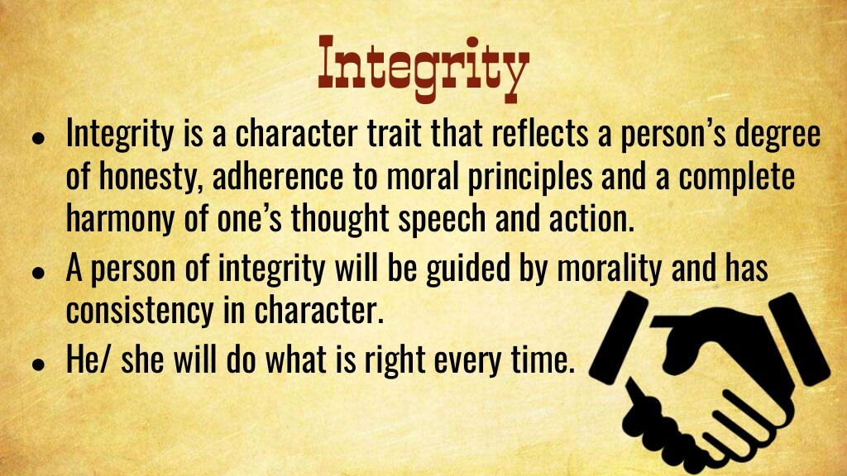

Slide 3
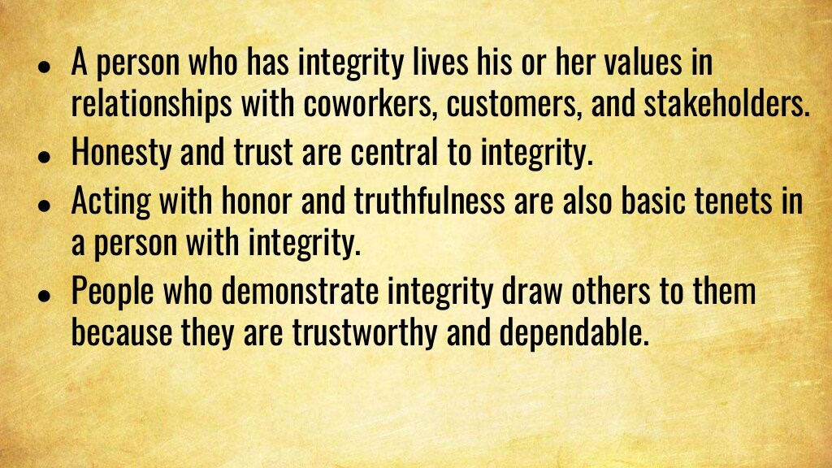

Slide 4
Integrity
Integrity is defined as the unity of thought, word and deed (honesty) and open mindedness. It includes the capacity to communicate the factual information so that others can make well-informed decisions. It yields the person’s ‘peace of mind’, and hence adds strength and consistency in character, decisions, and actions. This paves way to one’s success. It is one of the self-direction virtues. It enthuse people not only to execute a job well but to achieve excellence in performance. It helps them to own the responsibility and earn self-respect and recognition by doing the job.
Moral integrity is defined as a virtue, which reflects a consistency of one’s attitudes, emotions, and conduct in relation to justified moral values.

Slide 5
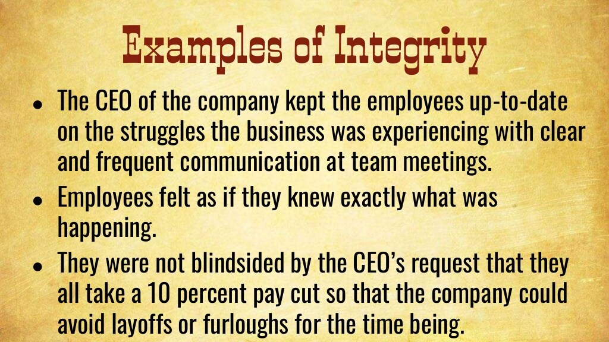

Slide 6
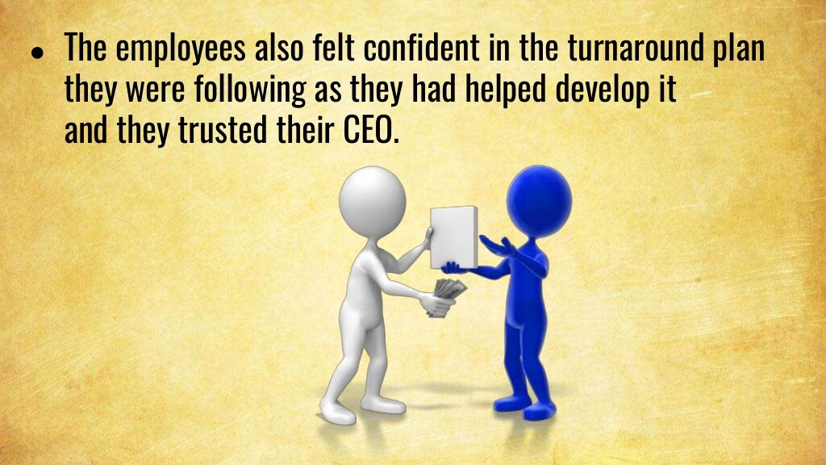

Slide 7
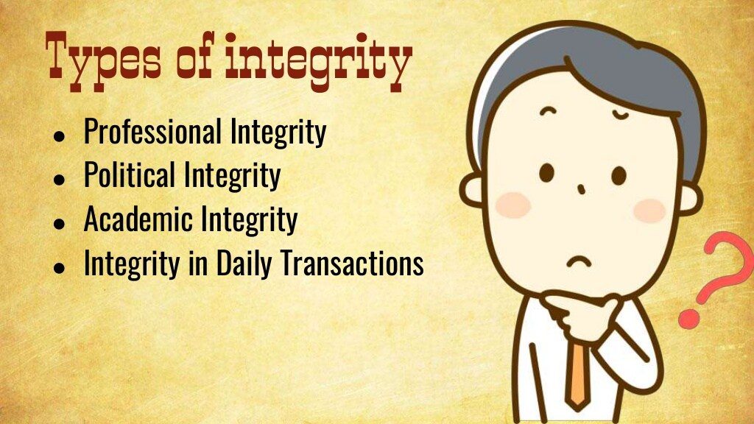

Slide 8
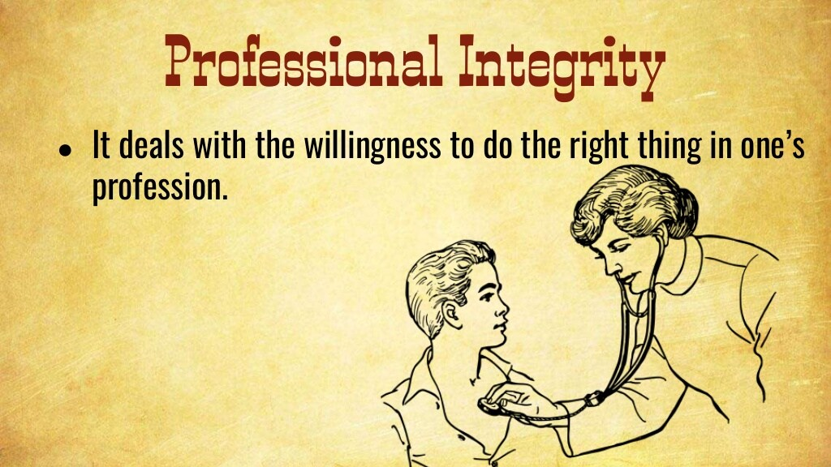

Slide 9


Slide 10
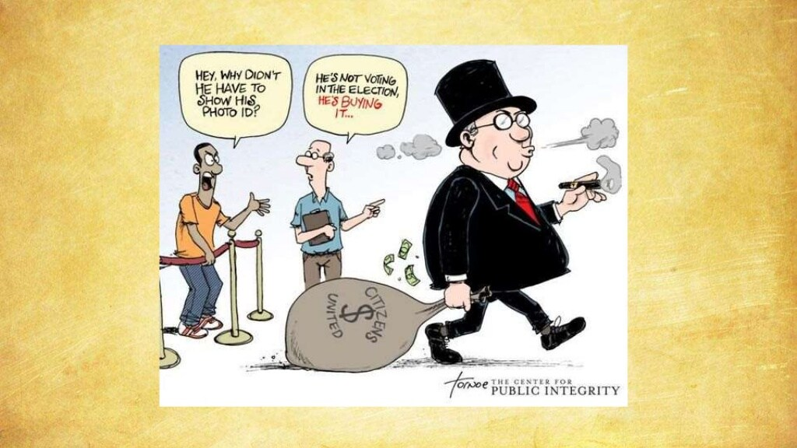

Slide 11
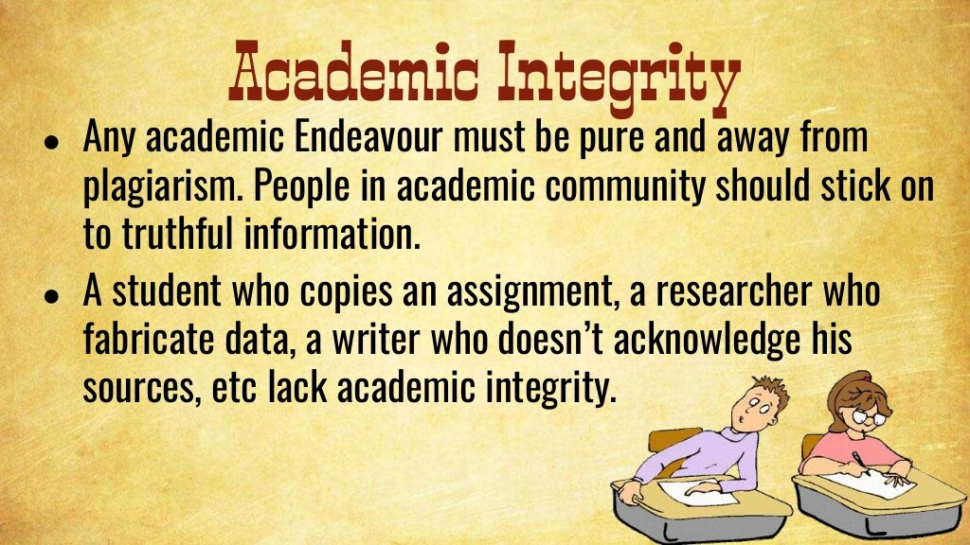

Slide 12
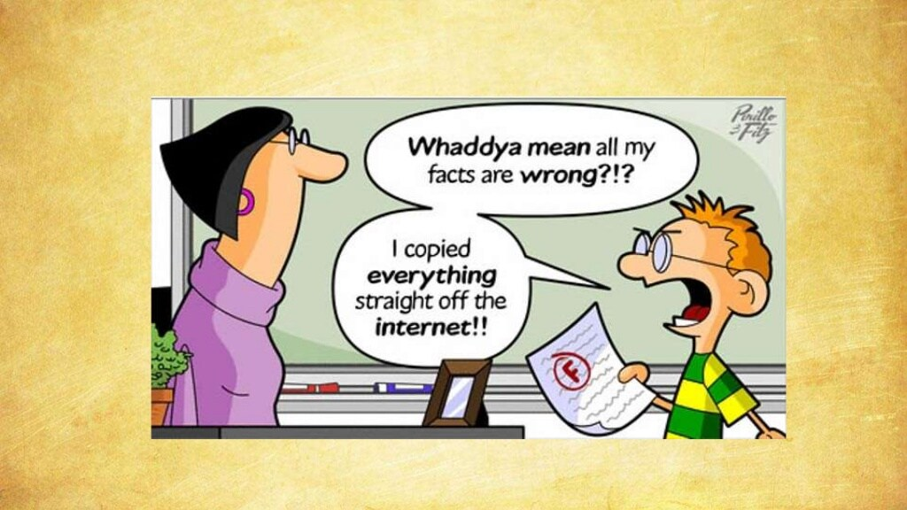

Slide 13
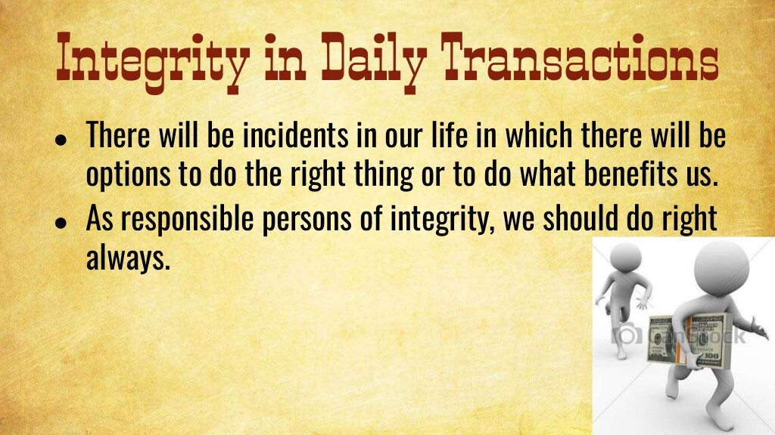

Slide 14


Slide 15
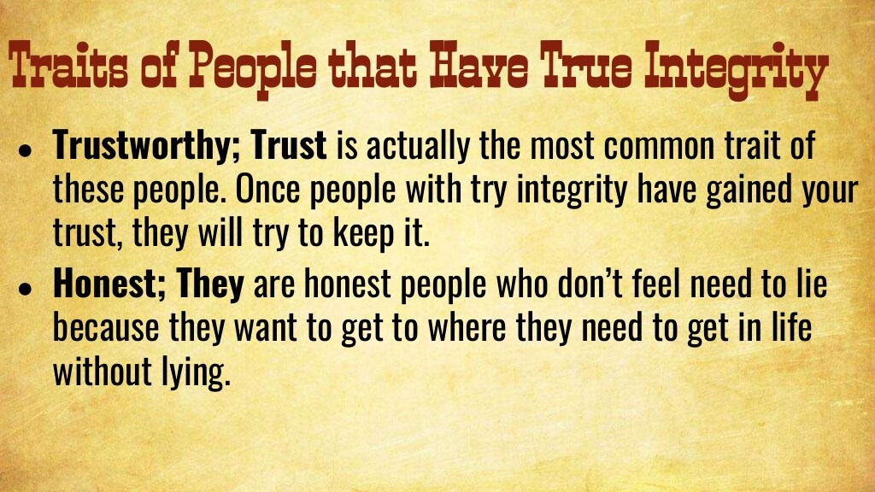

Slide 16
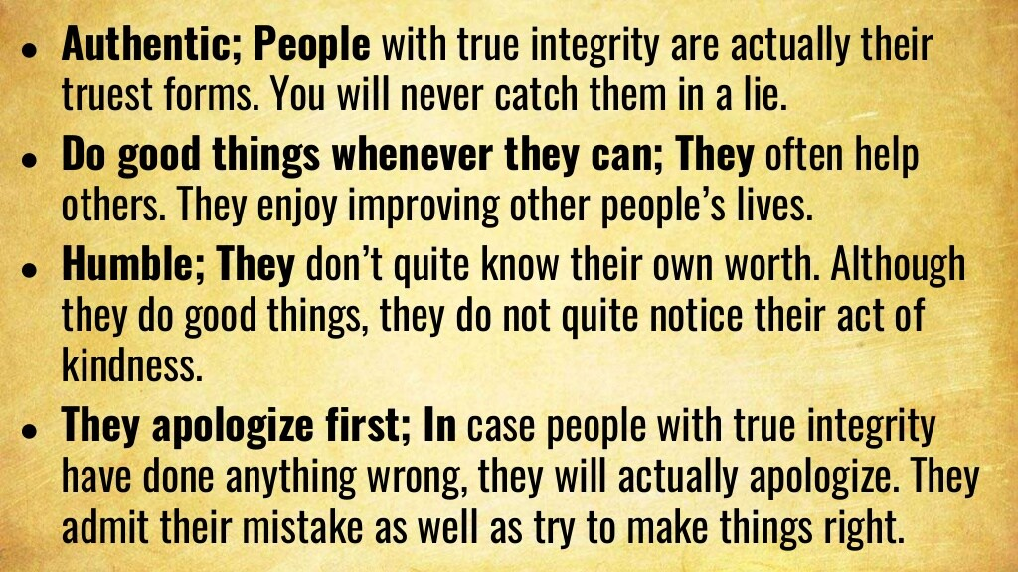

Slide 17
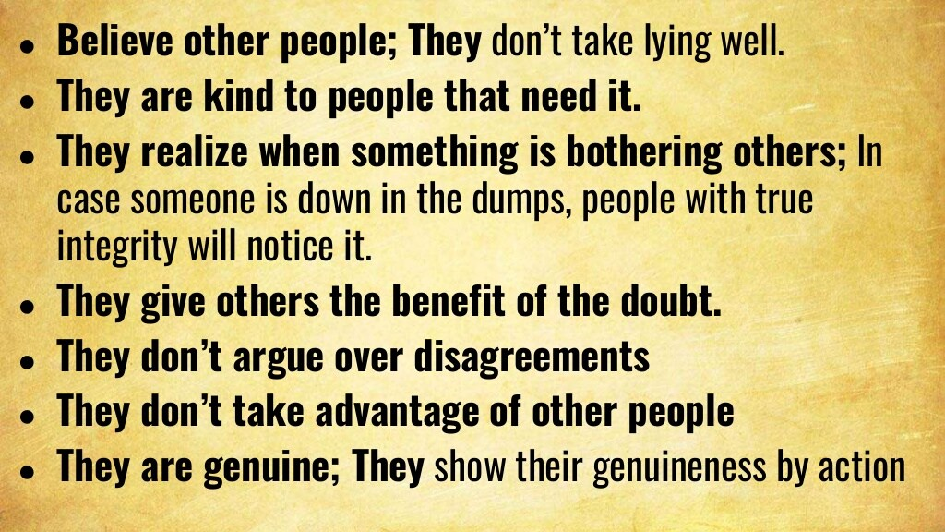

Slide 18
